Slide 1










DIABETES PREDICATION
Analysis
SQL Project
By: T.A Siva Bhavani

Slide 2
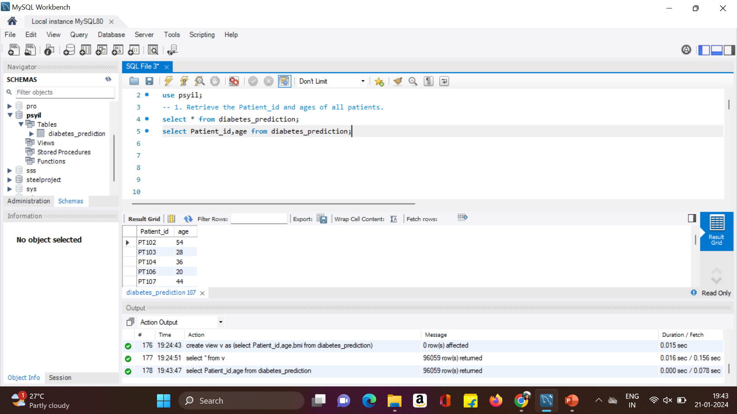
1. Retrieve the Patient_id and ages of all patients.

Slide 3
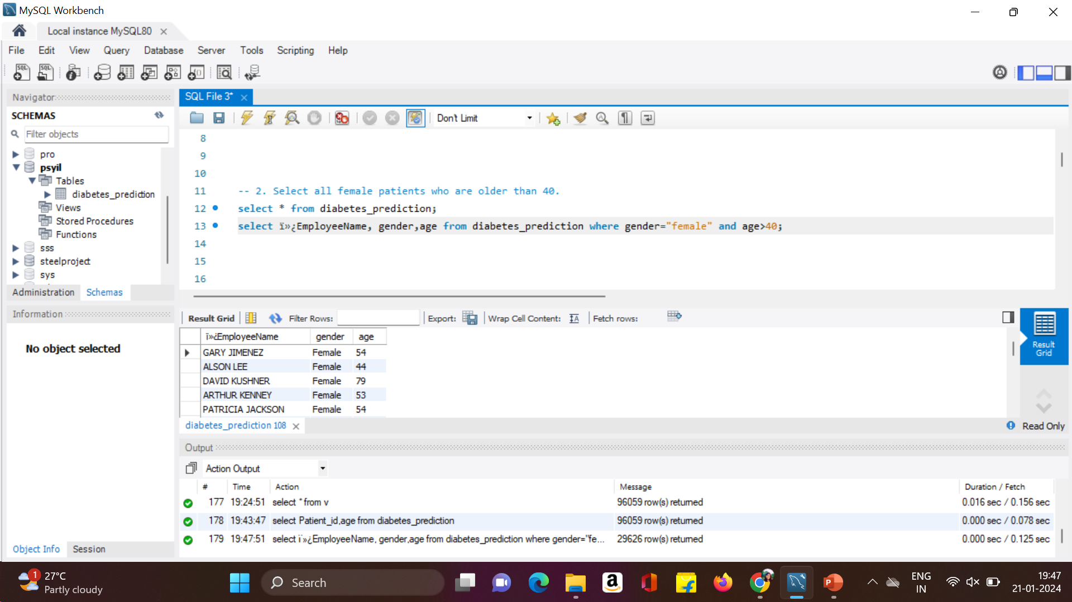
2.Select all female patients who are older than 40.

Slide 4
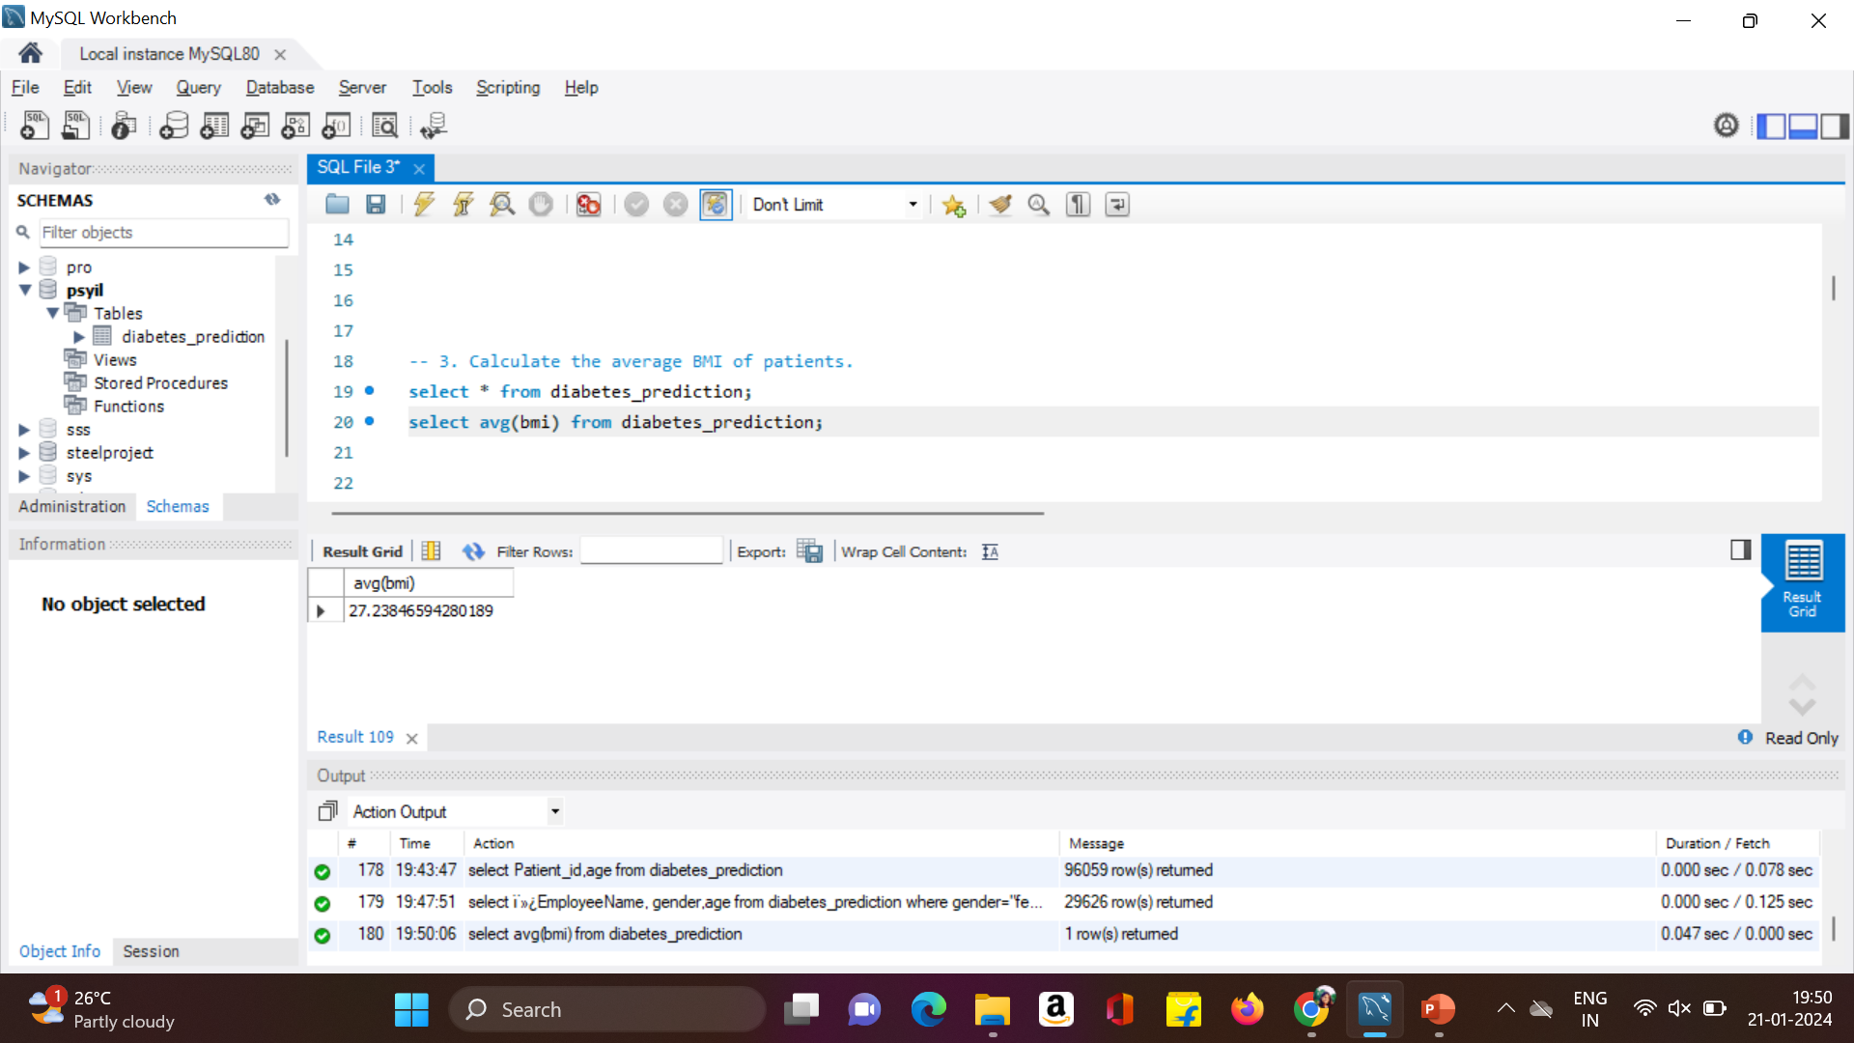
3. Calculate the average BMI of patients.

Slide 5
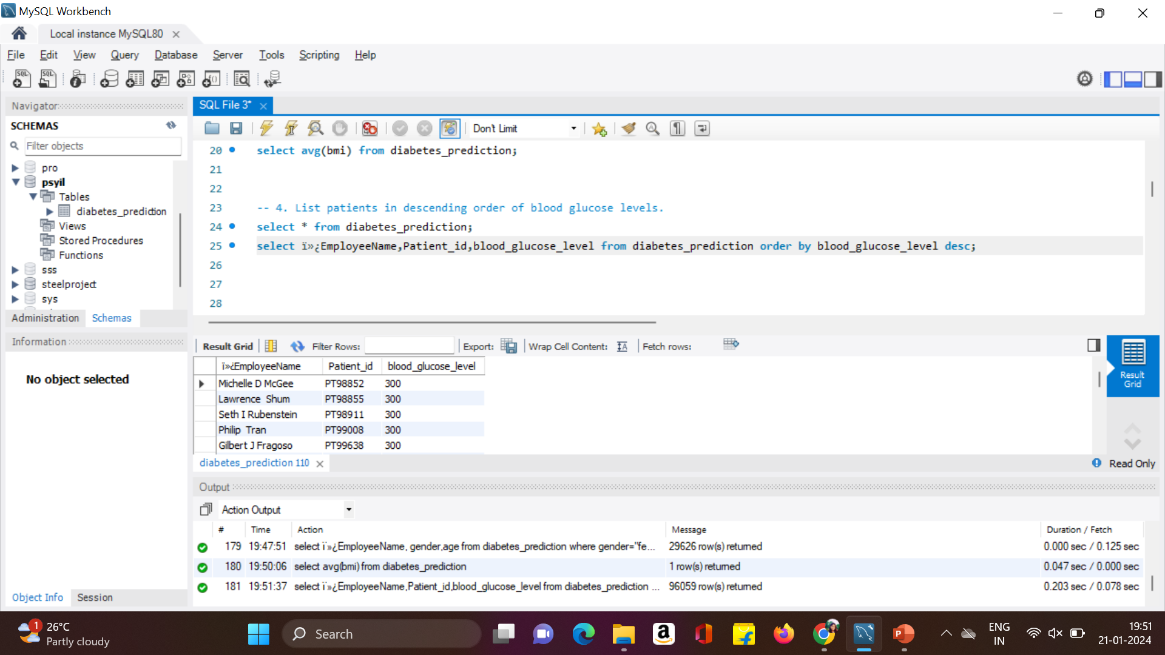
4. List patients in descending order of blood glucose levels.

Slide 6
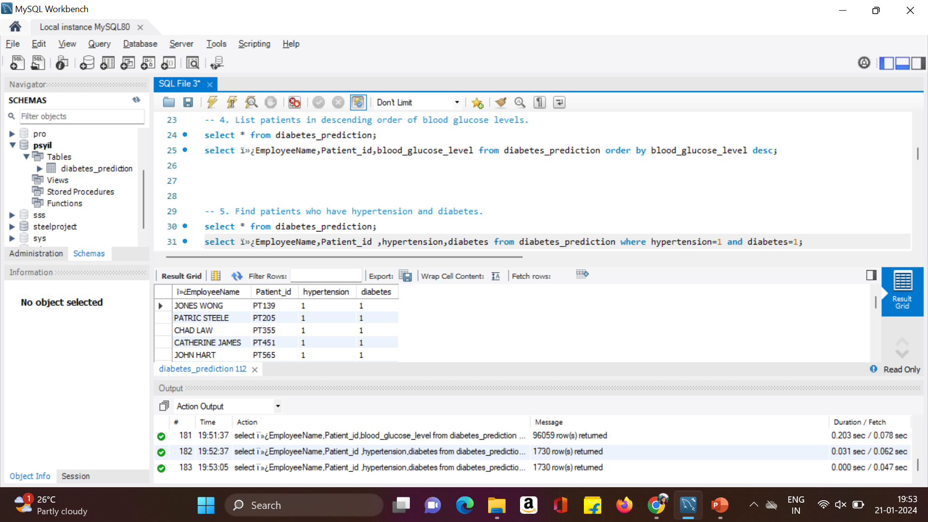
5. Find patients who have hypertension and diabetes

Slide 7
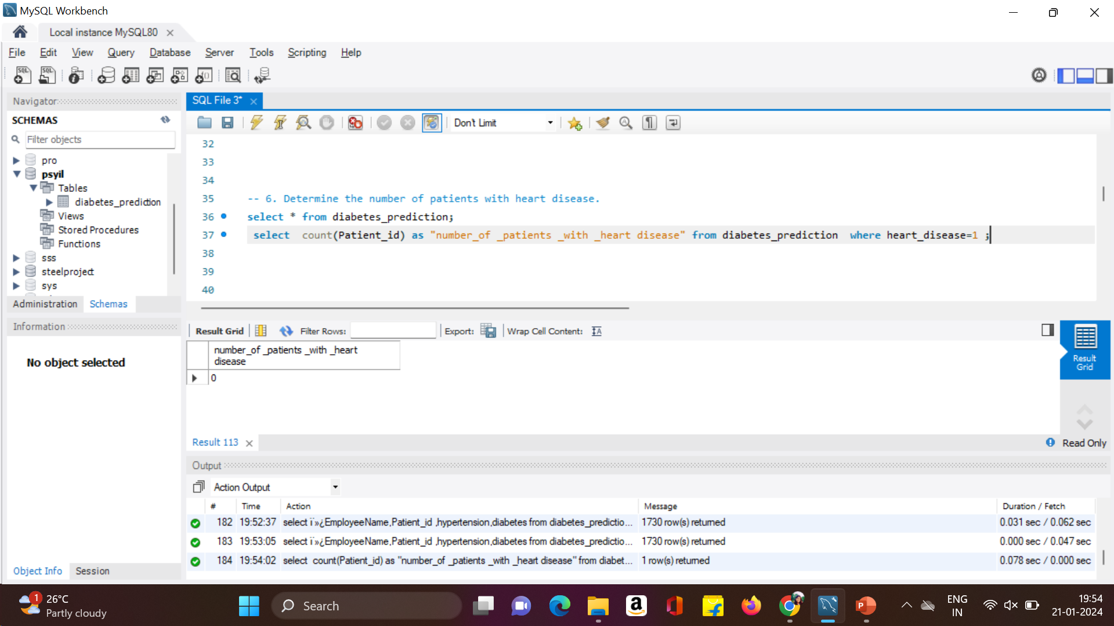
6.Determine the number of patients with heart disease.

Slide 8
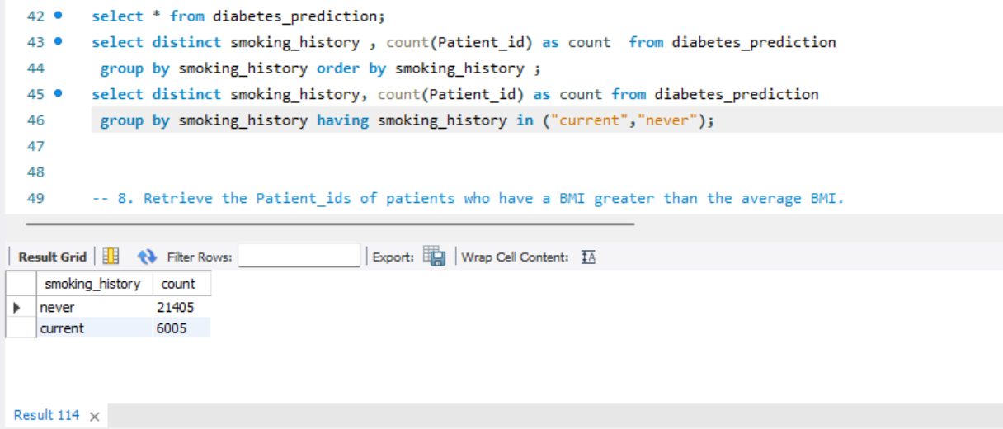
7. Group patients by smoking history and count how many smokers and nonsmokers there are.

Slide 9
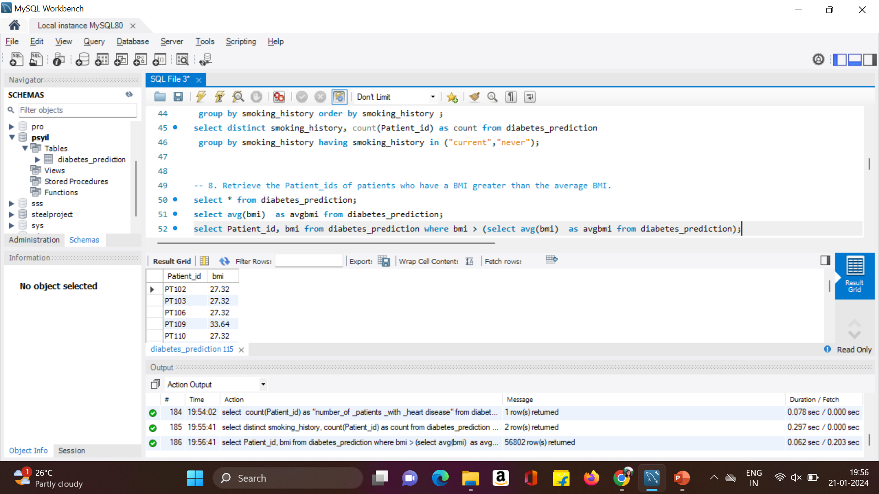
8. Retrieve the Patient_ids of patients who have a BMI greater than the average BMI.

Slide 10
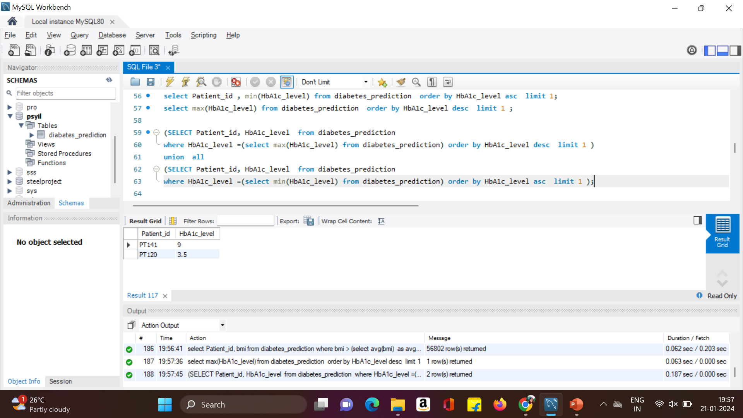
9. Find the patient with the highest HbA1c level and the patient with the lowest HbA1clevel.

Slide 11
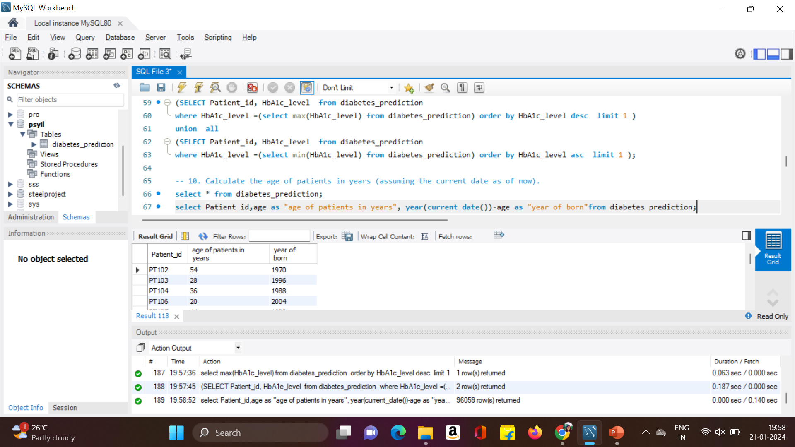
10. Calculate the age of patients in years (assuming the current date as of now).

Slide 12
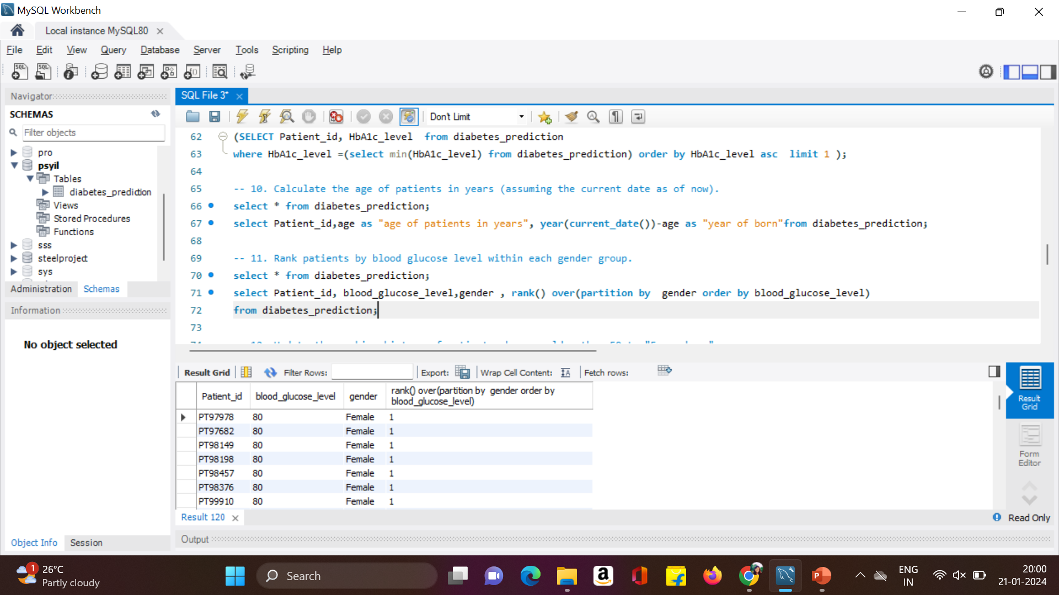
11. Rank patients by blood glucose level within each gender group.

Slide 13
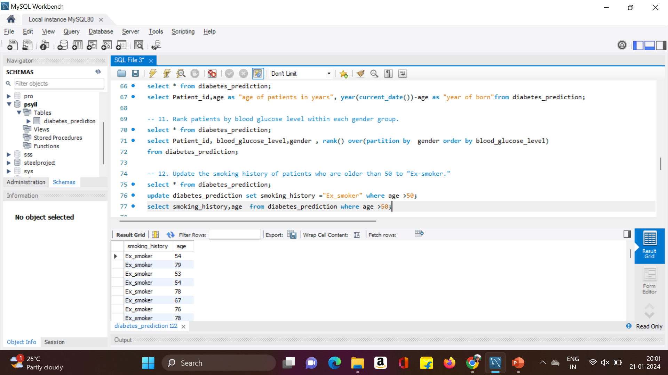
12. Update the smoking history of patients who are older than 50 to "Ex-smoker."

Slide 14
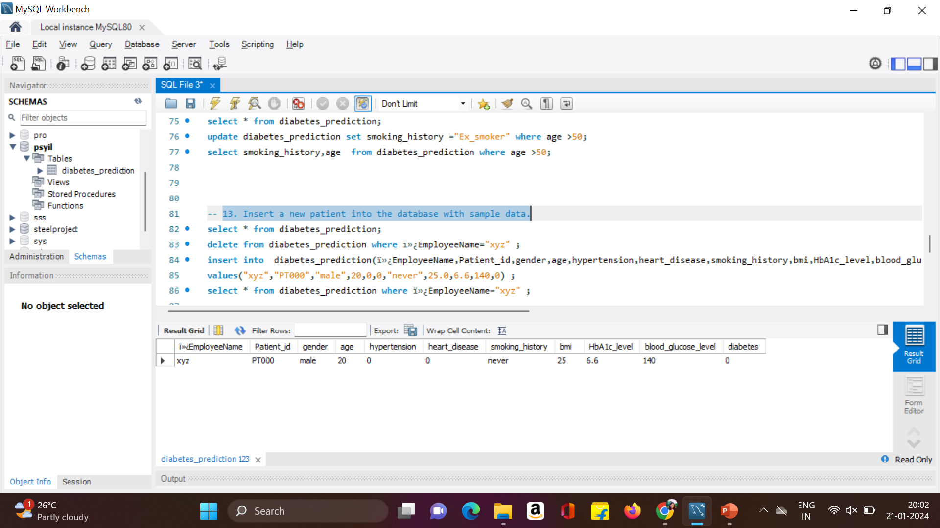
13. Insert a new patient into the database with sample data.

Slide 15
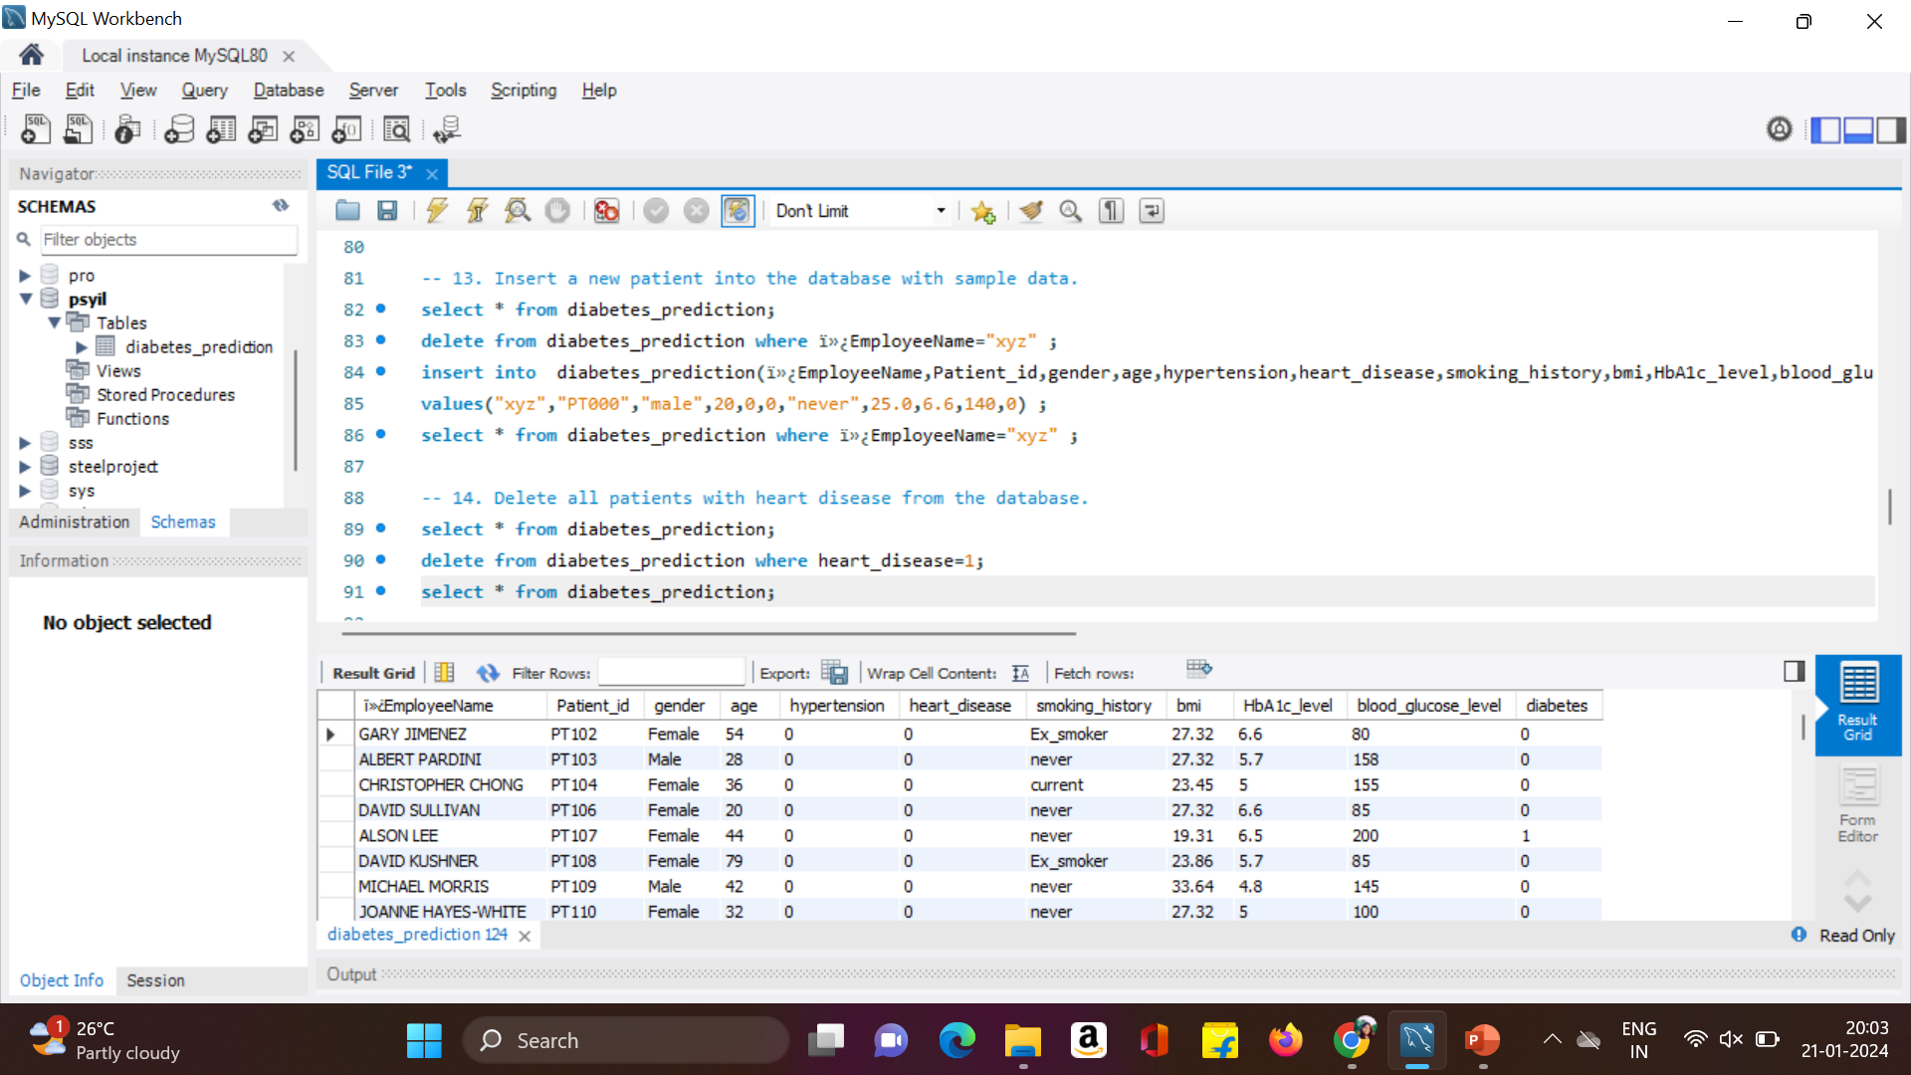
14. Delete all patients with heart disease from the database.

Slide 16
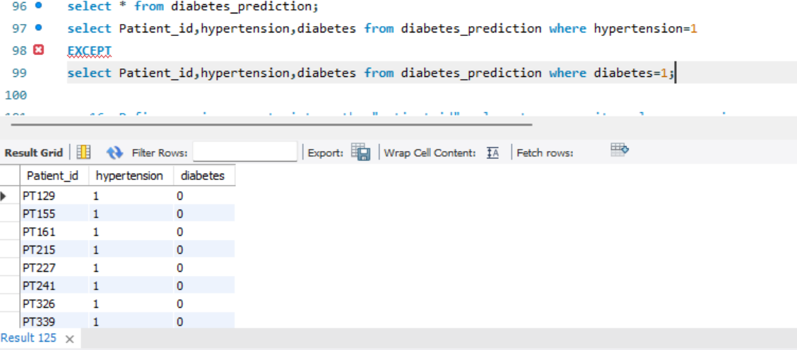
15. Find patients who have hypertension but not diabetes using the EXCEPT operator.

Slide 17
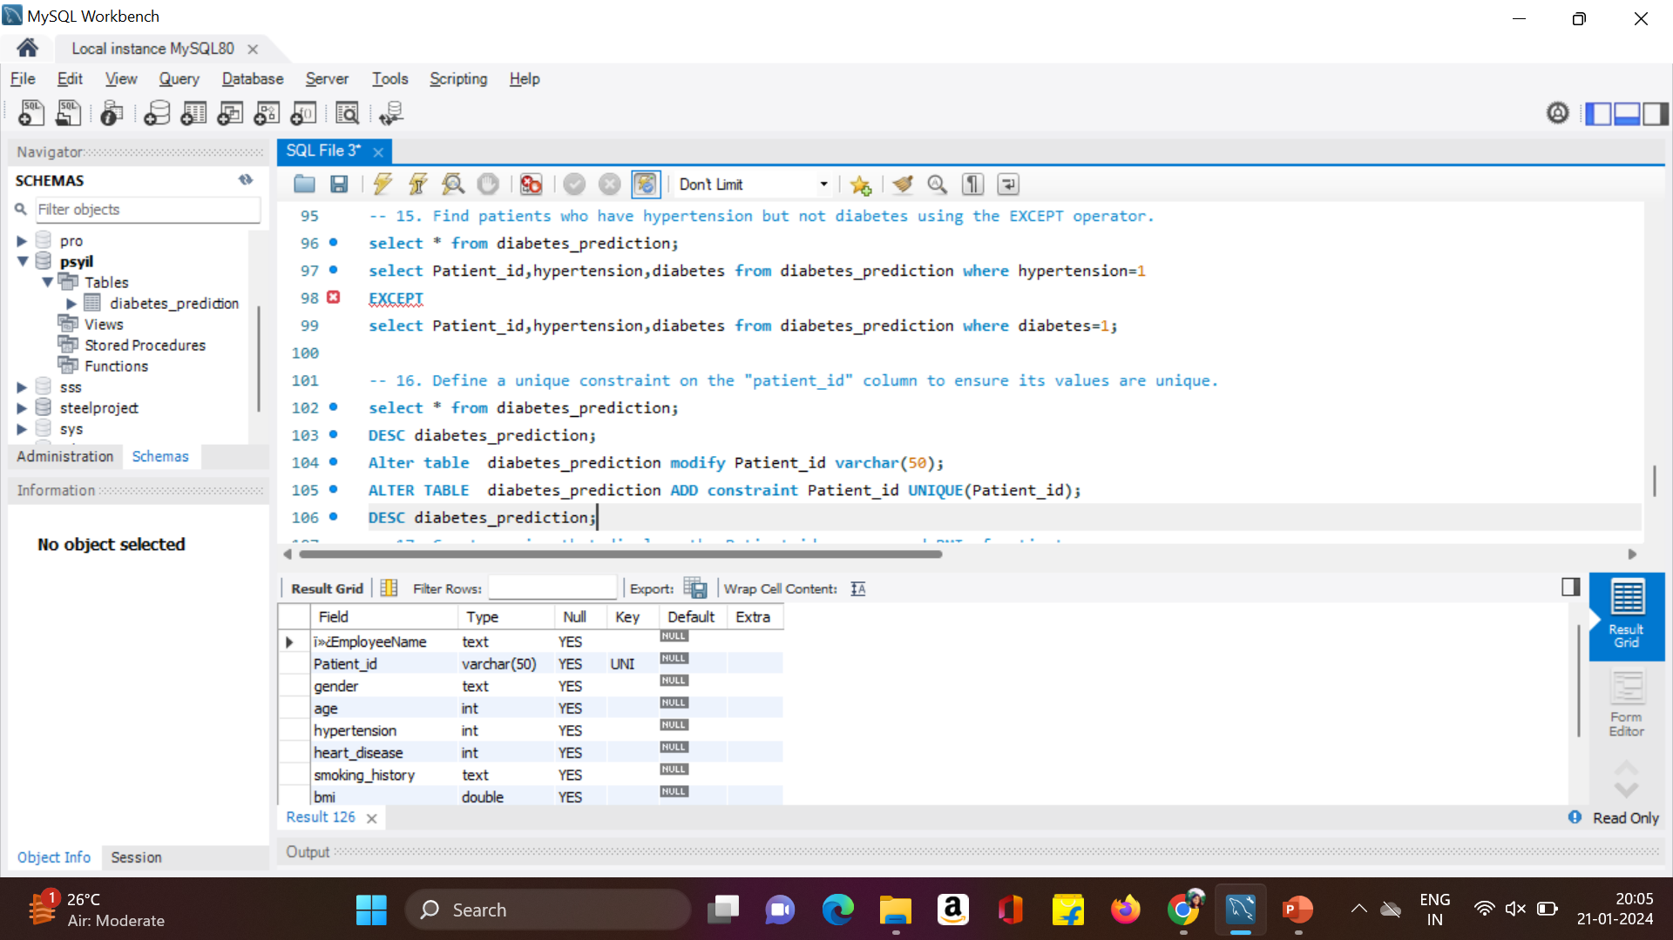
16. Define a unique constraint on the "patient_id" column to ensure its values are unique.

Slide 18
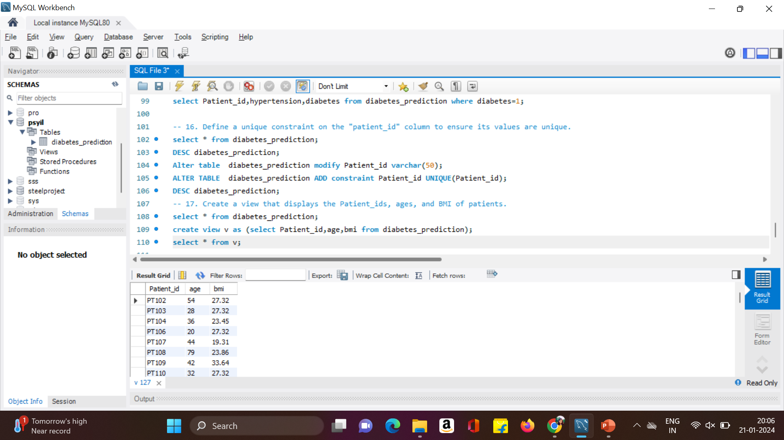
17. Create a view that displays the Patient_ids, ages, and BMI of patients.

Slide 19
18. Suggest improvements in the database schema to reduce data redundancy and improve data integrity.
To reduce data redundancy and improve data integrity in a database schema, we can consider the following best practices:
Normalization:
Apply normalization techniques to eliminate redundancy and dependency issues. This involves breaking down tables into smaller, related tables to reduce data duplication.Ensure data is stored at the most granular level possible and relationships between entities are properly represented.
Use Primary and Foreign Keys:
Define primary keys for each table to uniquely identify each record.
Establish foreign key relationships between tables to ensure referential integrity.
Data Types:
Choose appropriate data types for each column. This not only improves data integrity but also saves storage space.
Ensure Constraints:
Implement constraints such as NOT NULL, UNIQUE, and CHECK constraints to maintain data integrity.
Use triggers or stored procedures to enforce complex business rules
Indexes:
Use indexes wisely to improve query performance. However, avoid creating too many indexes, as they can impact write performance.

Slide 20
19. Explain how you can optimize the performance of SQL queries on this dataset.
Use Indexing:
Proper indexing can significantly improve query performance. Identify columns frequently used in WHERE clauses, JOIN conditions, and ORDER BY clauses, and create indexes on those columns. However, avoid over-indexing, as it can impact write performance.
Optimize JOIN Operations:
Use appropriate JOIN types (INNER JOIN, LEFT JOIN, etc.) based on the relationships between tables. Ensure that join columns are indexed. Consider denormalization for read-heavy queries if normalization causes performance issues.
Write Efficient Queries:
Use aggregate functions judiciously and consider using the GROUP BY clause only when necessary.
Limit the Result Set:
Use the LIMIT clause to restrict the number of rows returned, especially for large datasets.
Use pagination techniques to retrieve a subset of data at a time.
Avoid SELECT DISTINCT:
Use SELECT DISTINCT sparingly, as it can be resource-intensive. Consider if there are alternative ways to achieve the desired results without using DISTINCT.
Write queries that retrieve only the necessary columns and rows. Avoid using SELECT * if you don't need all columns.

Slide 21






THANK YOU

